Slide 1
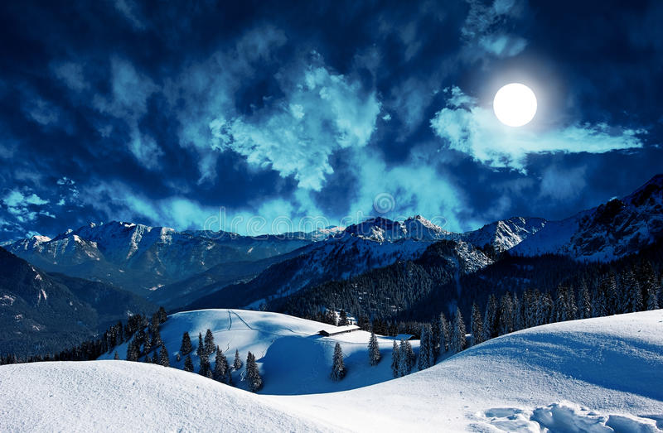
Chapter 12
First meeting with Mr Rochester

Slide 2

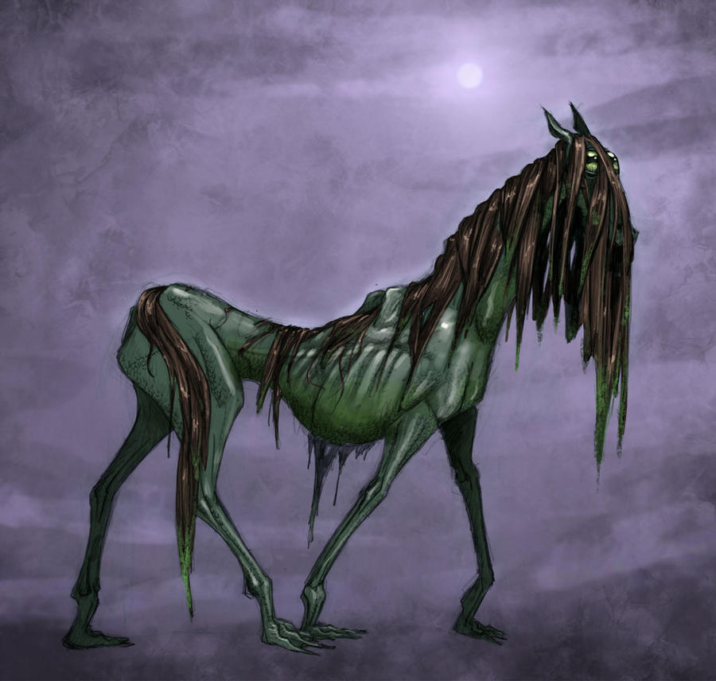
The supernatural
Bessie’s tales
Gloomy atmosphere
Gytrash

Slide 3
Sight | Sound
- seeing his master | - I heard - a sliding sound - echoed the sound

Slide 4
The two characters’ personality
Jane is helpful and daring
The man seem brave and autonomous

